Slide 1
Claim Management
System

Slide 2
Table of Content
?
What/Why
Technology
?
Problem Statement
Software/Hardware
Overview
A Closer Look
Vvvv
Features
Our Team
Architecture

Slide 3

What/Why is Claim
Management ?

Slide 4

What And Why?
Claims is a right of insured to receive the amount secured under the policy of insurance contract promised by Insurer.
Insurance Claim is the request of the insured policy holder/beneficiary from the insurer/insurance issuing company for financial reimbursement whenever he/she suffers a loss of the insured property/life/health/etc.
Responsibilities
Recording of the report of the claim
Checking coverage
Requesting notices
Skills
Risk Management or Claim administrator experience
Ability to manage claim strategies
?

Slide 5
Problem Statement
A leading HealthCare Management Organization wants to strengthen its middleware by exposing the core logic related to Claims Management as Micro-services.
The middleware Micro-services are to be hosted on cloud.
Member portal to be developed that consumes these micro-services back to members who are in need of Claim related Information
?

Slide 6
Overview
1) Authorization Micro-service
2) Claims Micro-service
3) Member Micro-service
4) Policy Micro-service
5) Member Portal
6) Swagger

Slide 7
Features
Submit Claim:
The user can insert the claim details like :
ID
Hospital Name
Claim Amount
A claim ID will be generated corresponding to the submitted claim.
Check Status :
The user can check the status of a particular claim with the given claim ID. For instance, Claim is pending as more documents are needed for verification.
View bills :
The User can see if he/she has any pending bills along with the last premium paid date and late charges

Slide 8
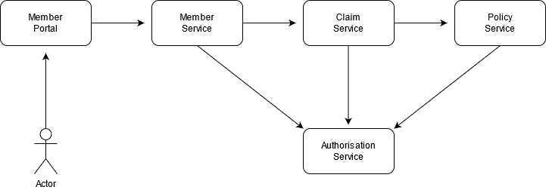
Architecture

Slide 9
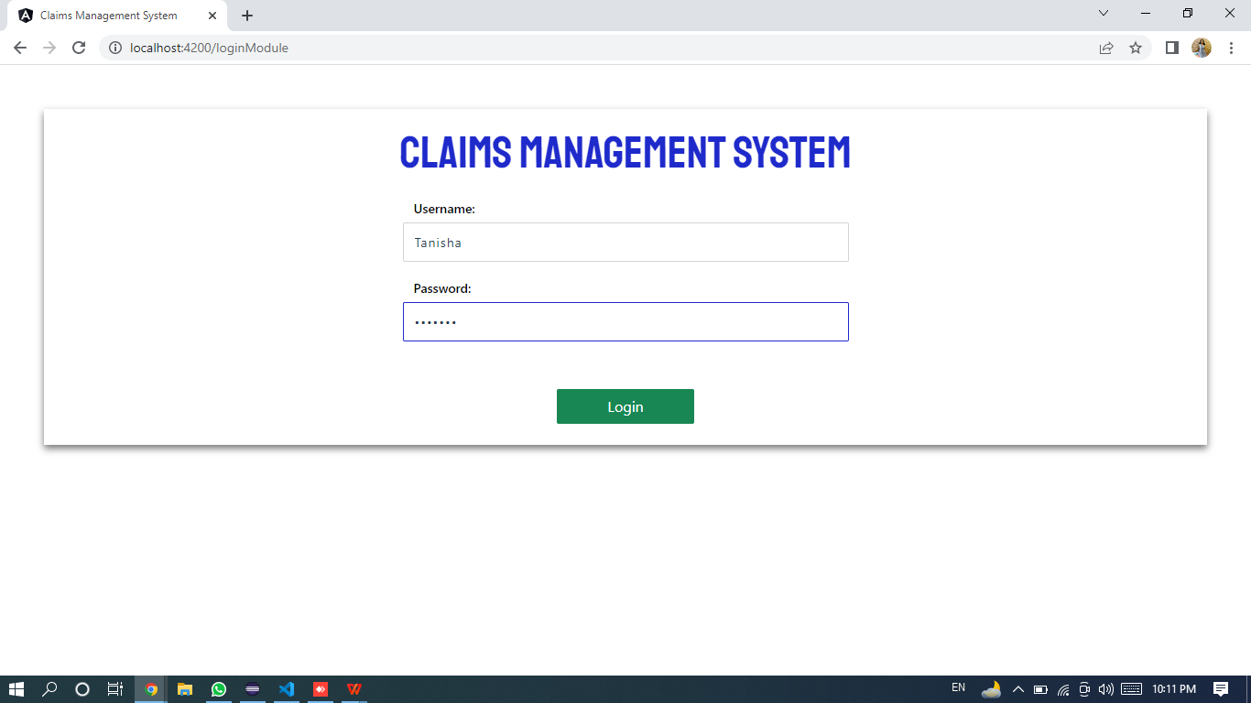
Member Portal

Slide 10
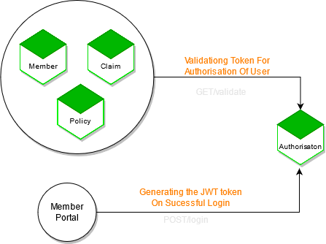
Authorisation Module

Slide 11
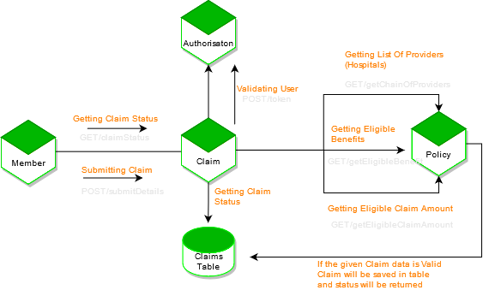
Claims Module

Slide 12
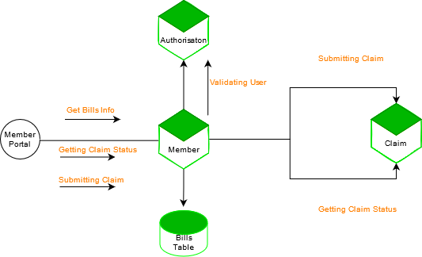
Member Module

Slide 13
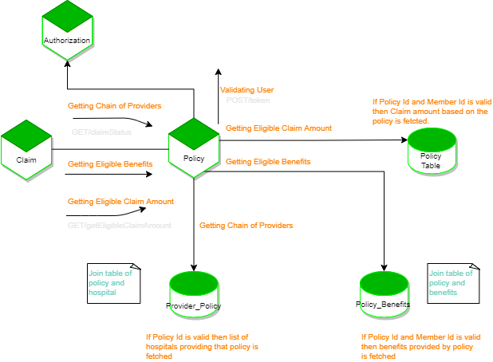
Policy Module

Slide 14
Technology Used
Frontend :
Angular, HTML, CSS, Type Script (TS)
Backend :
Spring MVC with Spring Boot, Spring Data JPA, H2 In Memory DB
Testing :
jUnit 5
DEVOPS & Cloud :
Docker, AWS - EC2
Ancillary :
Maven

Slide 15
Software/Hardware
Software:
Visual Studio, Eclips
Hardware:
4GB/8GB RAM, Intel i5,i9

Slide 16
A Closer look

Slide 24
Our Team
Tanisha Mitra
Raushan Kumar
Ebin Antony
Mrunalini Dhoble
Nimma Sreevardhan

Slide 25
Thank You!

